Slide 1
Unit City, State
Month-Day, 2020
Notes:
Title Slide Option 2

Slide 2
WHY POPCORN?
70%+ Returned Locally
Fund our unit’s program
Character development
Awesome Rewards
Improve our camps and council resources
OVER $4 BILLION Returned SINCE 1980!

Slide 3
WHY POPCORN?

Slide 4
POPCORN = PROGRAM
Fund all your Scouting related expenses and activities that you want your Scouts to enjoy this year through Popcorn.
Yearly Membership Dues
Boys Life Magazine
Advancements & Awards
Camping Trips
Hikes
Blue & Gold Banquet
Christmas Party
Pinewood Derby
& More!
Unit Goal: $25,000 Scout Goals: $1,000 (each)

Slide 5
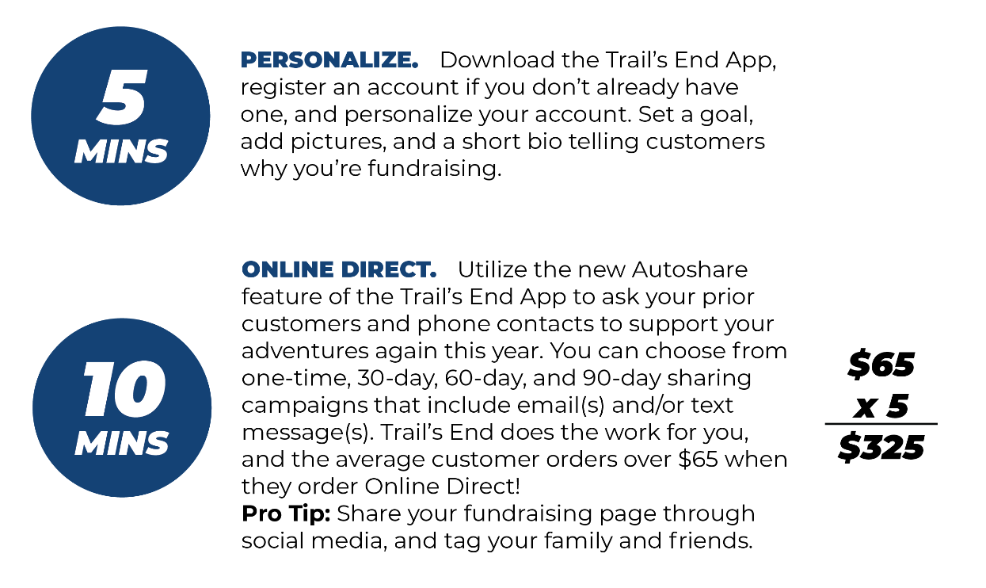
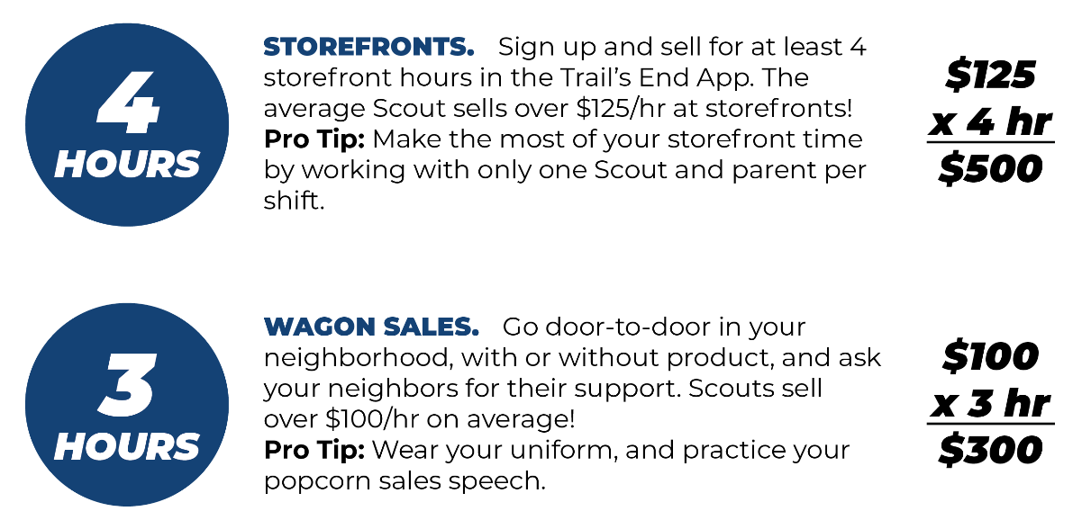

Slide 6
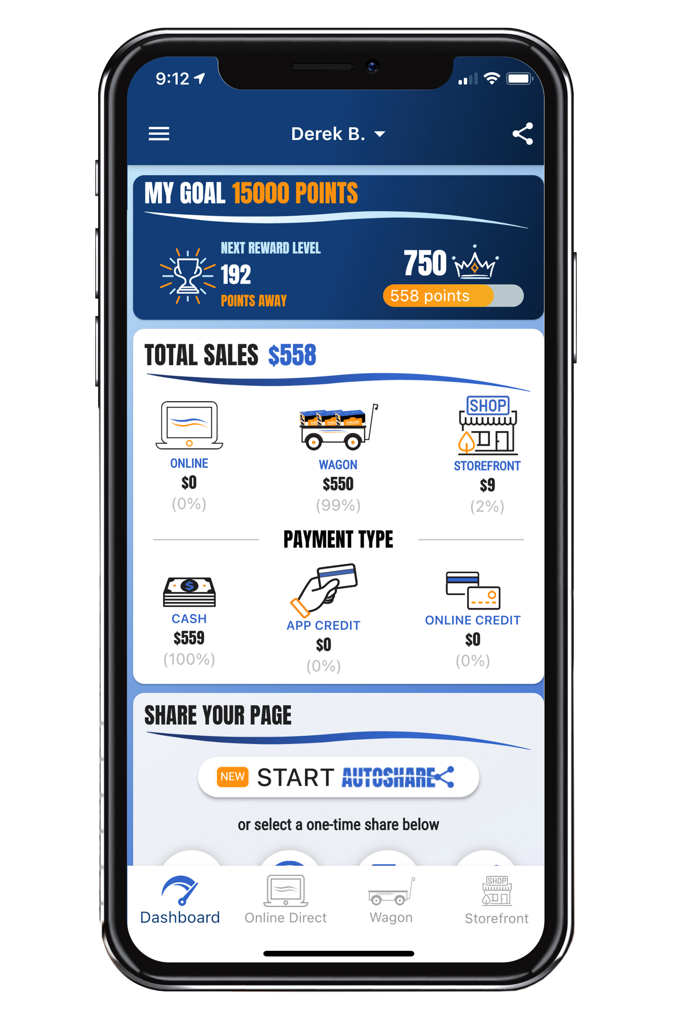
TRAIL’S END APP
The Trail’s End App supports ALL the ways our unit sells:
Online Direct
Share your Virtual Store Page
Record in-person sales in the App
Wagon Sales
Door-to-Door
At your parents’ workplace
Deliver now, or later
Storefronts / Booths
Credit card fees are paid by Trail’s End
Text APP to 62771 to download the Trail’s End App

Slide 7
TRAIL’S END APP
NEW in 2021!
Faster, Simpler, Fewer Clicks
AutoShare
Quickly share your Virtual Store to contacts in your phone
Share your Virtual Store to customers that ordered last year
Monthly Donation to American Heroes
In addition to the one-time donation, Online Direct customers can now choose to support with a monthly donation to American Heroes
Fund your entire year with just 5 sales of $19+ monthly donations
Recruit a Scout
Recruit friends and neighbors through the Trail’s End App
The information will be sent to the Leaders & Council
Text APPGUIDE to 62771 to download the App Quick Start Guide

Slide 8
LET’S STOP & REGISTER

Slide 9
TRAIL’S END REWARDS
Visit the App to Set Your Goal and See All Levels and Reward Ideas!
Earn MORE points with Online Direct
Bonus Rewards Challenges
Choose the prize YOU want on Amazon.com
Get prizes faster, delivered to your door

Slide 10
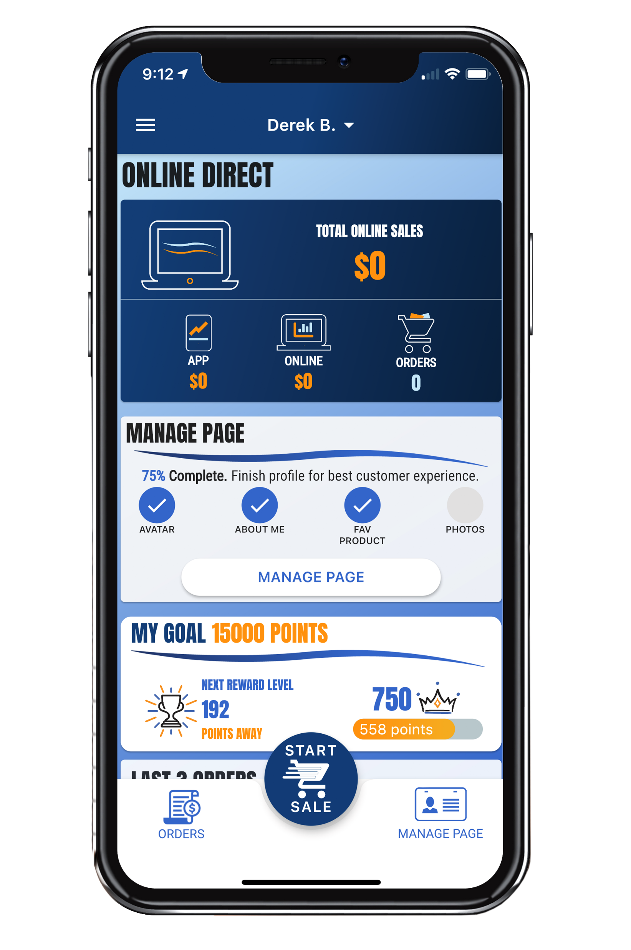
ONLINE DIRECT
Easiest & SAFEST Way for Scouts to Sell
Scouts Earn MORE Points for TE Rewards
Average Customer Order: Over $65!
Online Direct is Available Year-Round
No Handling of Products or Cash for Scout or Unit
New TE App Online Direct Features:
Take in-person Online Direct orders directly in the TE App
Text order to customer so they can complete the purchase on their phone
Monthly Gift to American Heroes: Fund your entire year with just 5 sales of $19+ monthly donations
Generate a QR code to share with your customers
Keep an eye out for App notifications about challenges throughout the year to earn BONUS POINTS
10

Slide 11
ONLINE DIRECT

Slide 12
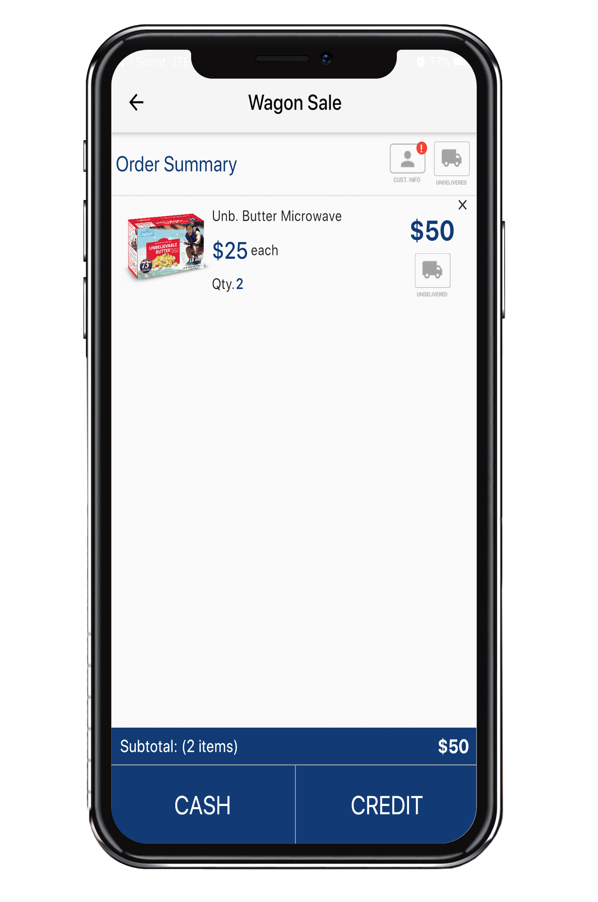
WAGON SALES
You can start taking orders now!
Sell door-to-door
Visit 30 homes in your neighborhood
Record ALL sales in the Trail’s End App
Be sure to mark orders as Undelivered or Delivered
NEW: Text order to customer to complete purchase on their phone to keep a social distance
Sell to friends & family
Ask parents to sell at work

Slide 13
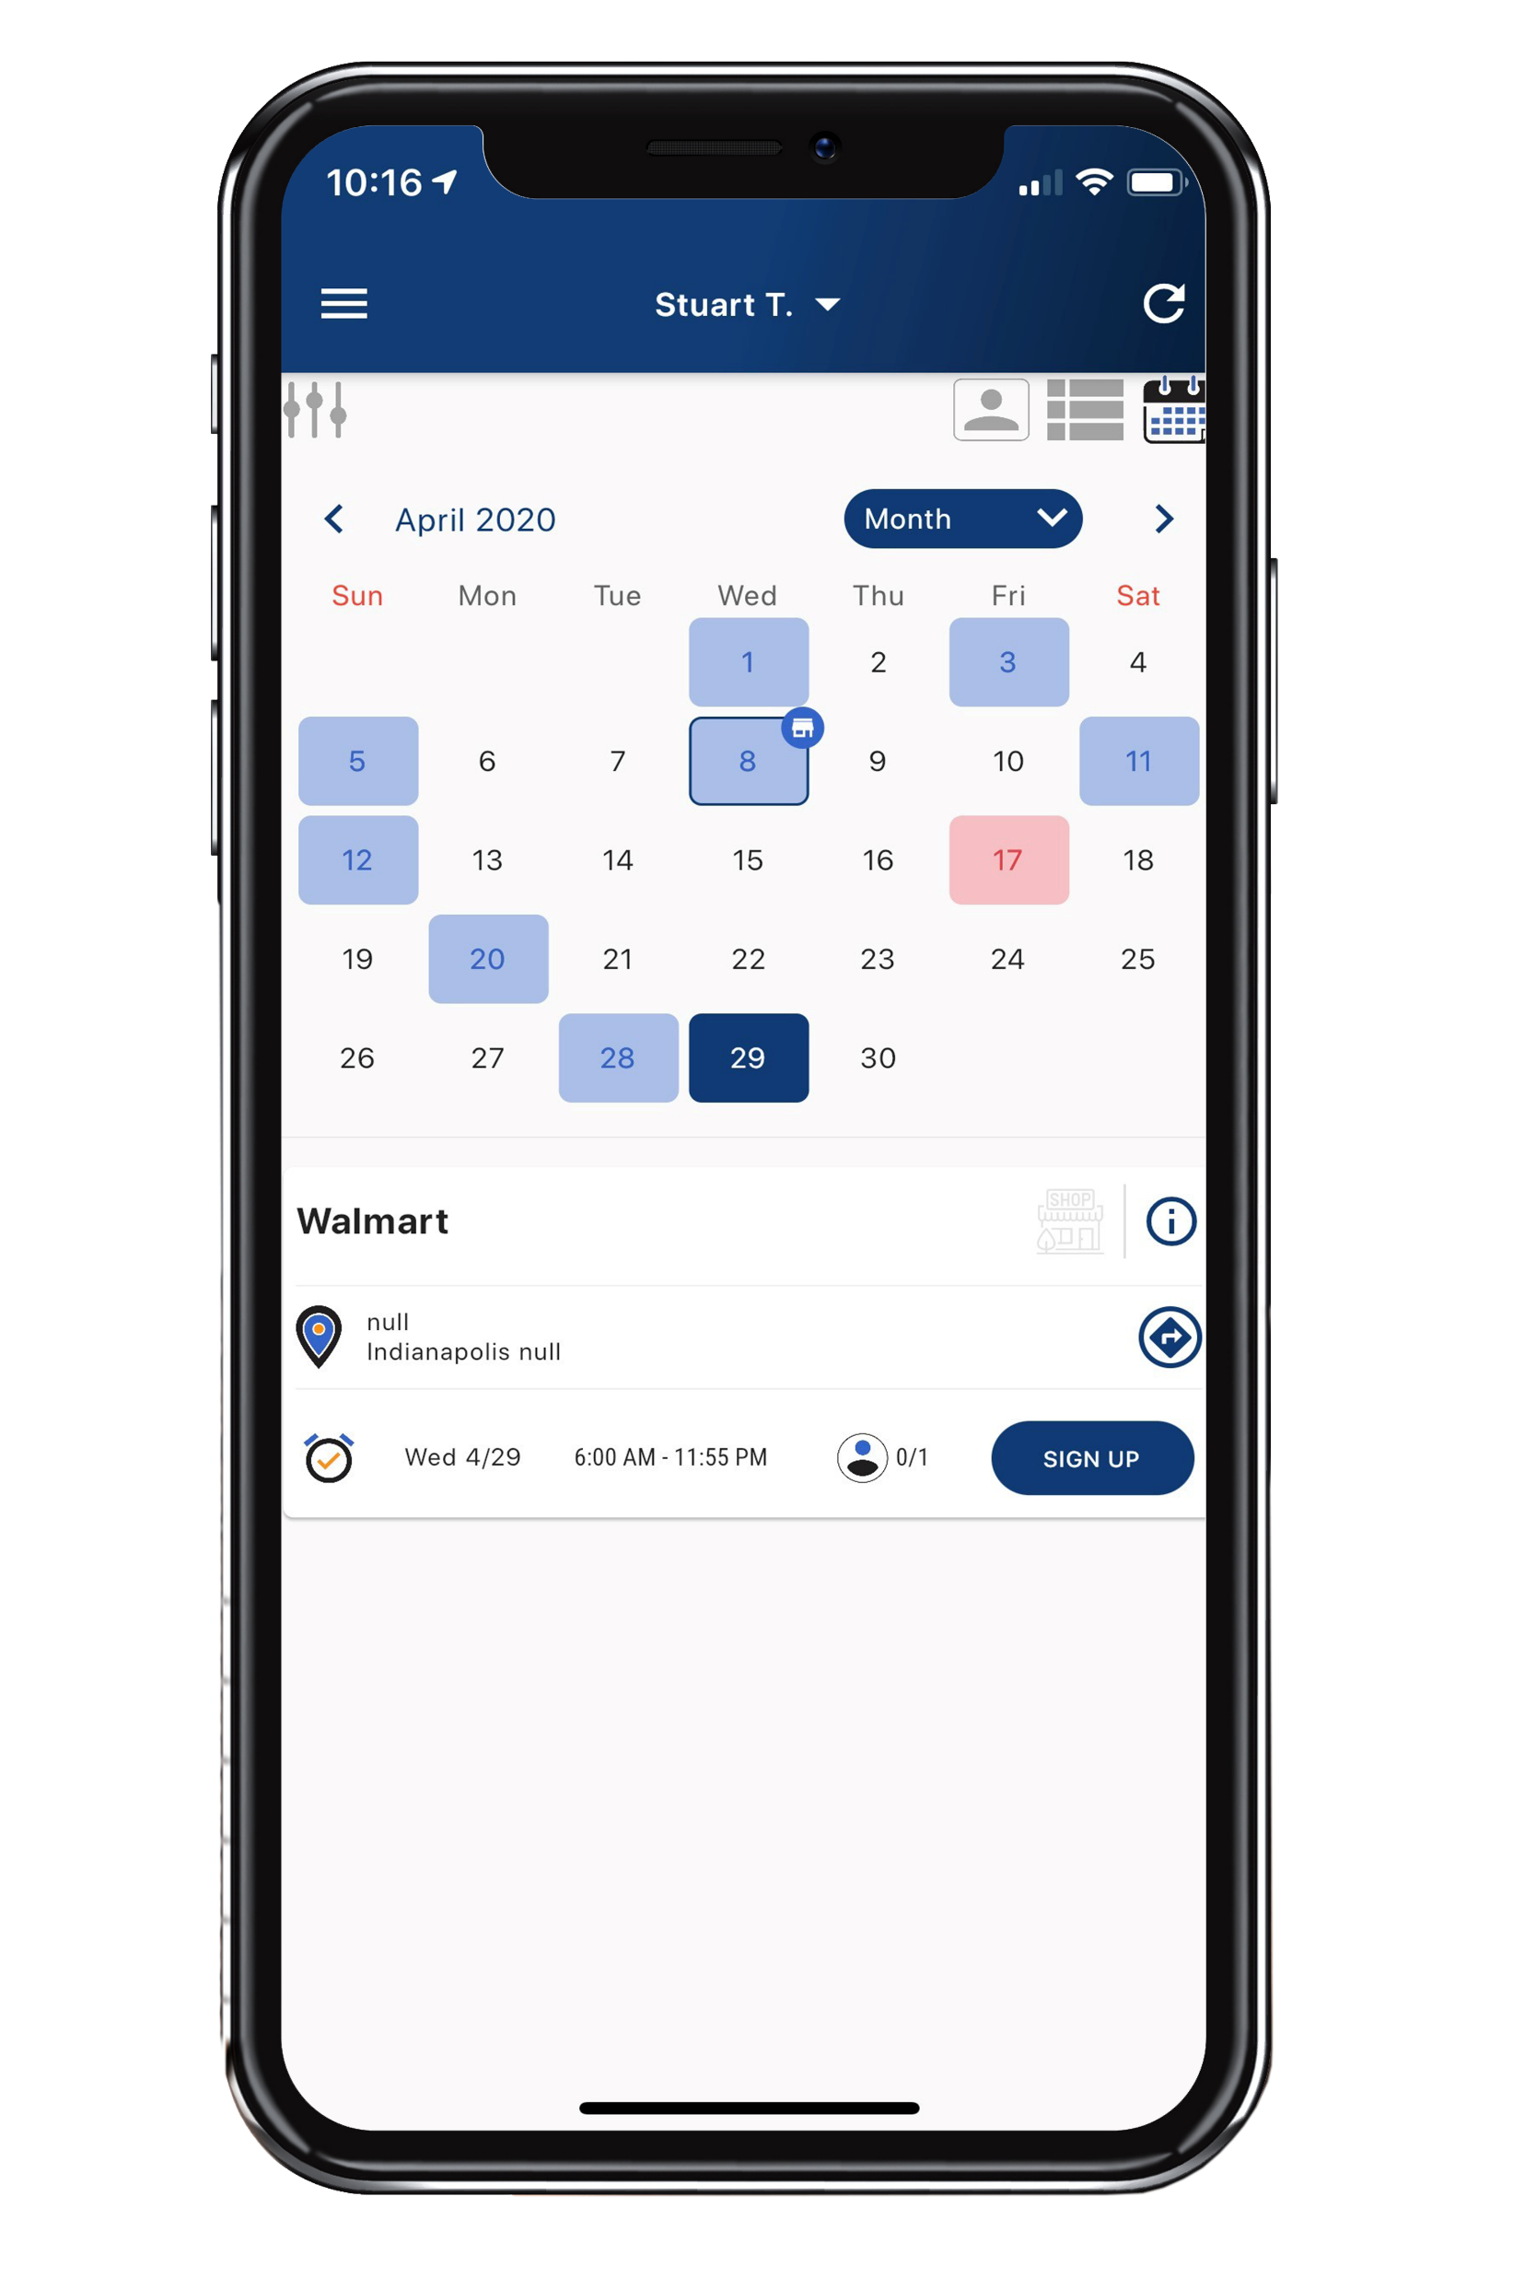
STOREFRONTS
Sign up for at least 4 storefront shifts!
Sign up in the Trail’s End App
Record ALL sales in the Trail’s End App
NEW: Text order to customer to complete purchase on their phone to keep a social distance
Remember to tell customers, “We prefer credit/debit!”
Customers spent 27% more with credit cards versus cash in 2019

Slide 14
CREDIT / DEBIT
CREDIT SALES ARE BEST FOR SCOUTS
TELL YOUR CUSTOMERS, “WE PREFER CREDIT/DEBIT”
Trail’s End pays for all credit card fees!
Bigger Rewards – Earn 1.5pts per $1 sold in the Trail’s End App
Safer – Scouts don’t have to handle cash
Higher Sales – Customers spent 27% more with credit vs. cash in 2019
Easier – Parents turn in cash sales with credit/debit payments to the unit
Hardware – Scouts can accept credit/debit with Square readers or manual entry

Slide 15
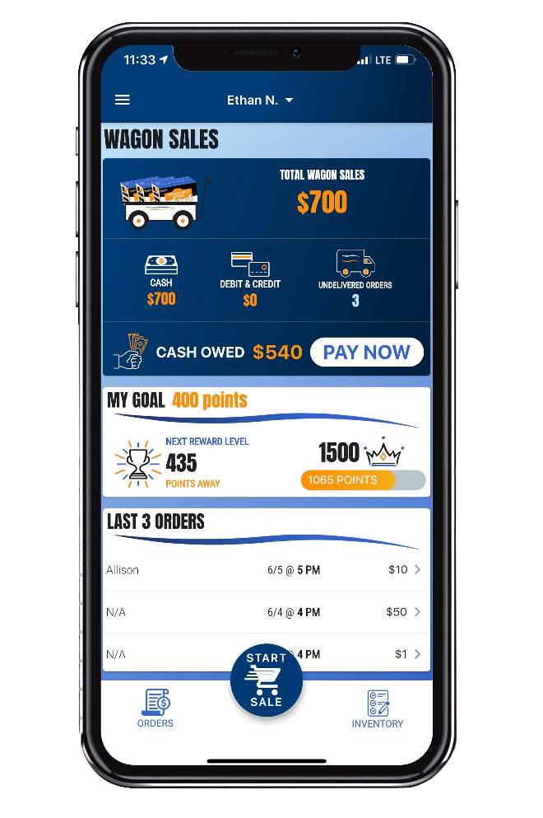
CREDIT / DEBIT
Turn in cash collected from Wagon Sales with a credit/debit payment to your unit.
Navigate to Wagon Sales in the App
Click PAY NOW
Enter the payment amount
You don’t have to pay the full amount at once
Swipe your credit card or enter manually and keep the cash
“Pay Now” does not count as a credit sale towards Trail’s End Rewards points
No need to carry around cash until you see your Popcorn Kernel. Pay your unit through the app at your convenience!

Slide 16
3 Simple Steps to Success
Always wear your uniform and introduce yourself with a smile.
Practice your popcorn sales speech.
Always say “Thank You” even if the customer does not make a purchase.
Example Speech: “Hi, my name is <Your Name>! I’m earning my way to summer camp. Can I count on your support? All of the popcorn is delicious, and you’ll help fund many adventures in Scouting. If you don’t have any cash, don’t worry, I can take credit cards!”

Slide 17
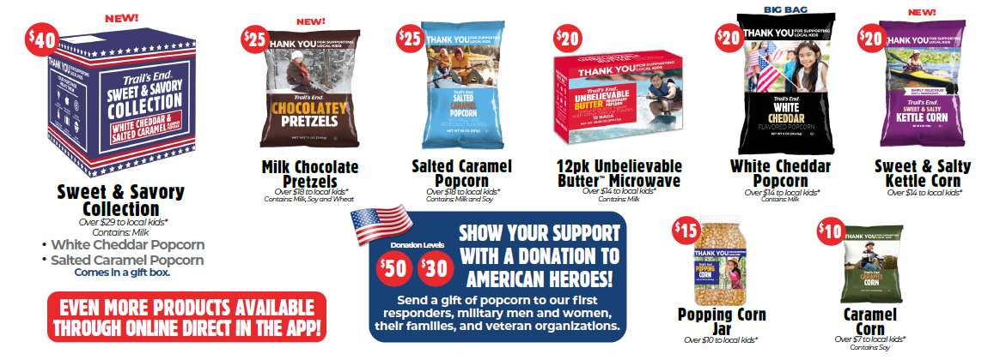
PRODUCTS - TRADITIONAL
$X
$X

Slide 18
DONATIONS
American Heroes Donation Program
When a customer purchases an American Heroes Donation, a portion of the purchase goes back to local kids and Trail’s End sends delicious treats to first responders, military men and women, their families, and veteran organizations. Trail’s End has teamed up with Soldiers’ Angels to distribute the popcorn to VA Hospitals, National Guard units, and military bases across the country.
Over $66 million worth of popcorn has been donated to U.S. troops over the years
In 2019, over 2,900 pallets of popcorn was shipped to 45 locations in 22 states
NEW in 2021: In addition to a one-time donation, customers now have the option to sign up for a monthly donation amount (minimum $5)!

Slide 19
KEY DATES
Online Direct & Wagon Start
Storefront Signups Live
First Storefront Sale
Last Day to Return Wagon
Last Storefront Sale
Popcorn Party
Aug. 1
July 23
August 25
October 12
October 14
TBD
19

Slide 20
SUPPORT
CONTACT TRAIL’S END SUPPORT
JOIN OUR FACEBOOK GROUP
Text PARENTFB to 62771 to join
VISIT OUR WEBSITE
www.trails-end.com
EMAIL US:
support@trails-end.com
NEED HELP? VISIT OUR FAQs:
https://support.trails-end.com
UNIT CONTACT INFO
Enter Name: Unit Kernel
@gmail.com
(000) 000-0000
Enter Name: Unit Co-Kernel
@gmail.com
(000) 000-0000
20

Slide 21
THANK YOU
Let’s Have a Great Fundraiser!
AMERICA’S POPCORN SALE - FUNDING ADVENTURES!
OVER $4 BILLION BACK TO SCOUTING SINCE 1980

Slide 22
THANK YOU!

