Slide 1
Enter Unit
2020 Popcorn Kickoff
June 11, 2020

Slide 2
WHY POPCORN?
73% Return to Scouting
Fund our unit’s Scouting program
Scout character development
Awesome Scout Rewards
Improve our camps and council resources
OVER $4 BILLION Returned to SCOUTING SINCE 1980

Slide 3
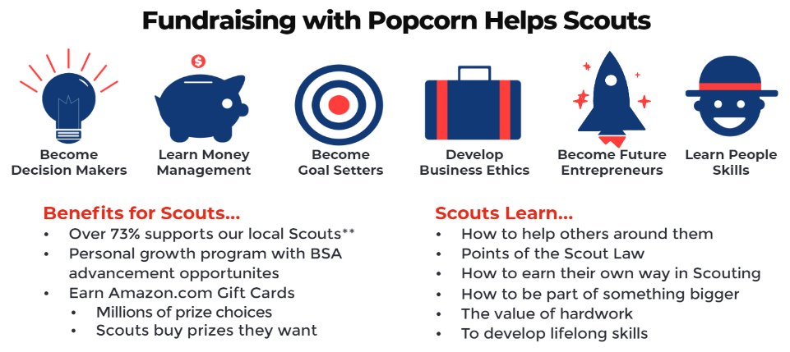
WHY POPCORN?

Slide 4
POPCORN = PROGRAM
Fund all your Scouting related expenses and activities that you want your Scouts to enjoy this year through Popcorn.
Yearly Membership Dues
Boys Life Magazine
Advancements & Awards
Camping Trips
Hikes
Blue & Gold Banquet
Christmas Party
Pinewood Derby
& More!
Unit Goal: $25,000 Scout Goals: $1,000 (each)

Slide 5
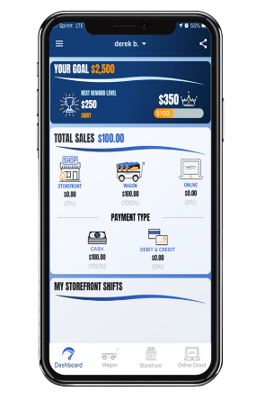
TRAIL’S END APP
The Trail’s End App supports all the ways our unit sells:
Online Direct
Friends & Family
Wagon Sales / Door-to-Door
Parent’s Workplace
Storefronts / Booths
Locations where you can setup a table
Credit card fees are paid by Trail’s End
Text APP to 62771 to download the App

Slide 6
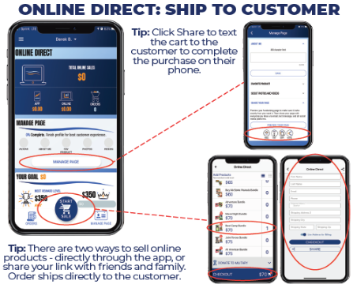
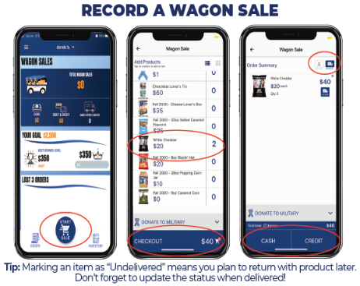
TRAIL’S END APP
Text APPGUIDE to 62771 to download the App Quick Start Guide

Slide 7
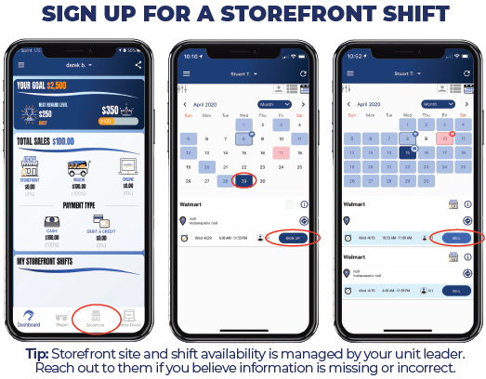
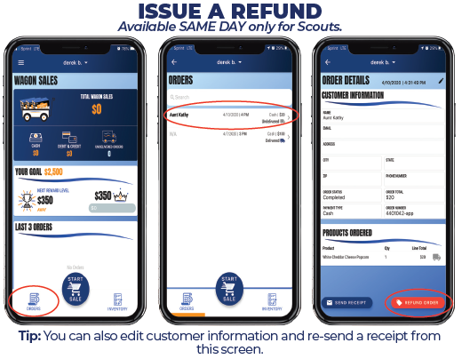
TRAIL’S END APP
Text APPGUIDE to 62771 to download the App Quick Start Guide

Slide 8
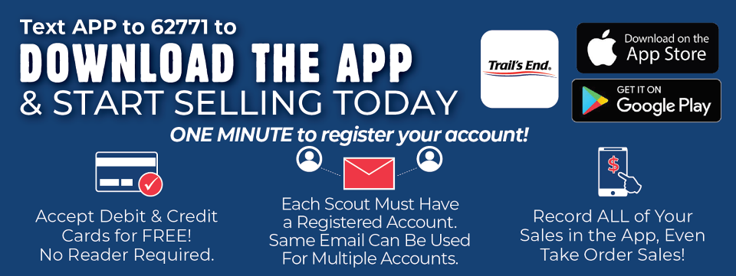
LET’S STOP & REGISTER

Slide 9
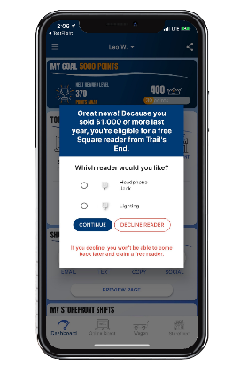
READER CLAIMING
Square Readers for Scouts – redeemed in the Trail’s End App beginning July 1:
Scouts who sold $1,000 - $3,499 in 2019 will receive a Square reader (headphone or lightning)
Scouts who sold $3,500+ in 2019 will receive a contactless Bluetooth reader
When the Scout first signs in starting July 1, they will receive a pop-up to…
Select a reader
Enter their shipping information
Your reader will ship from Trail’s End to the address you enter.

Slide 10
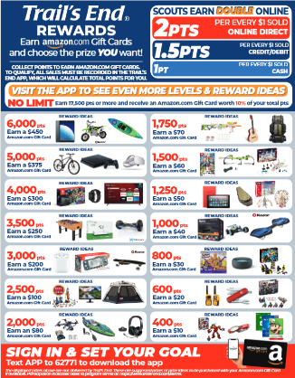
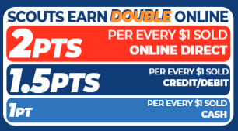
TRAIL’S END REWARDS
Visit the App to Set Your Goal and See All Levels and Reward Ideas!
Earn double points with Online Direct
Bigger prizes
Millions of choices on Amazon.com
Get prizes faster
Delivered to your door

Slide 11
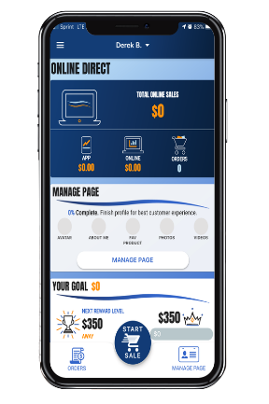
ONLINE DIRECT
Best & Preferred Way to Sell
Safest way for Scouts to sell
Scouts earn Double Points for TE Rewards
Traditional products and prices
$10 opening price point
No handling of products/cash for Scout or unit
New TE App Online Direct features:
Take Online Direct orders in the TE App
Text order to customer to complete purchase on their phone
Products popped fresh to order – shipped direct to customer.
Text MYPLAN to 62771 to download: How to Sell $1,000 Social Distancing
11

Slide 12
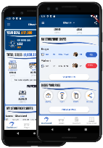
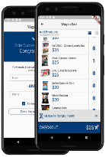
ONLINE DIRECT
HOW IT WORKS
TWO WAYS TO SELL
SHARE YOUR PAGE
Share your fundraising page via email, text, or social media.
Customers click you link to place online orders.
Products ship to your customers.
TAKE ONLINE DIRECT ORDERS IN THE APP
Pick your products.
Take payment (credit/debit only)
Products ship to your customers.

Slide 13
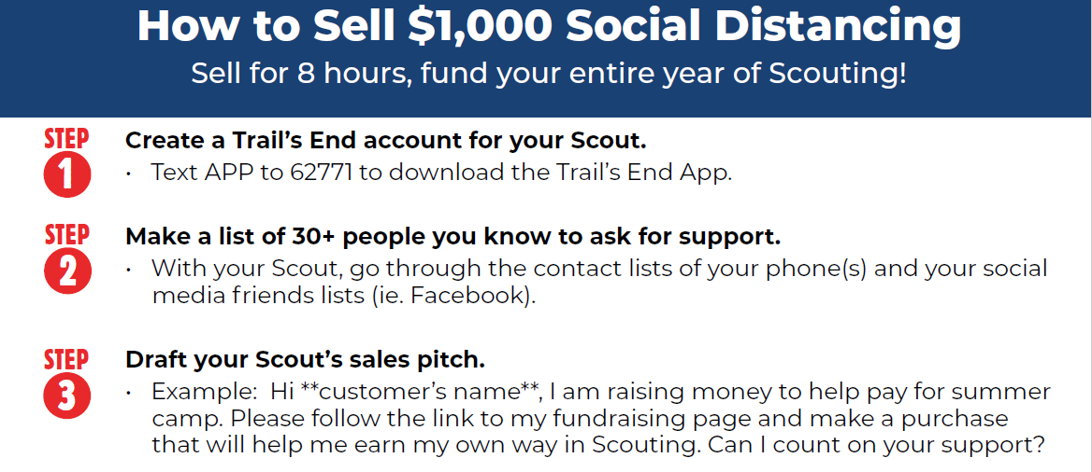

Slide 14
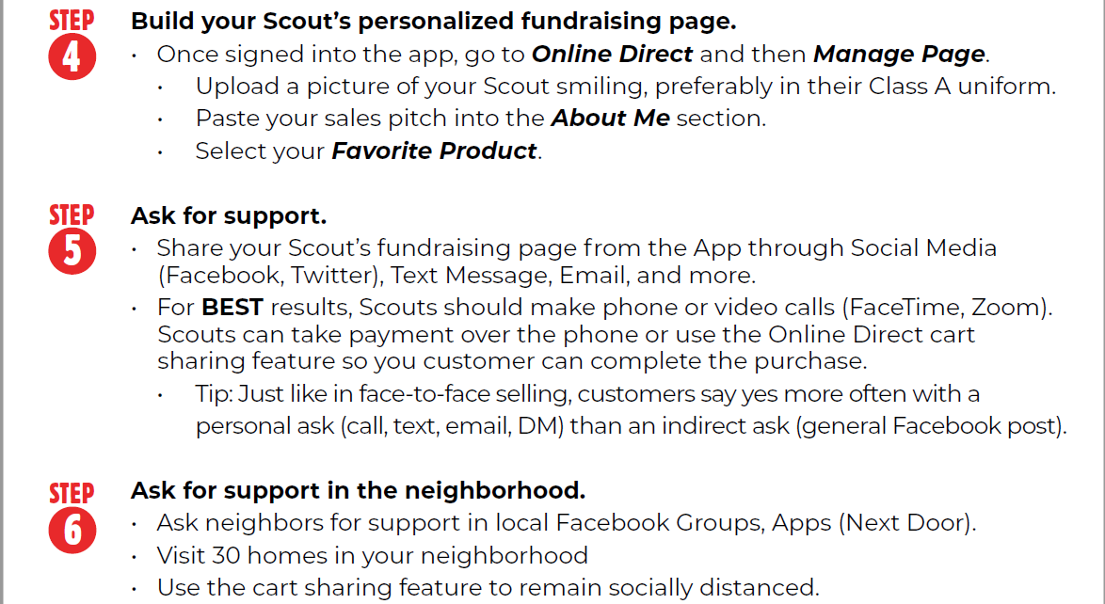

Slide 15
SALES PITCH
https://youtu.be/0XCq7XB6900

Slide 16
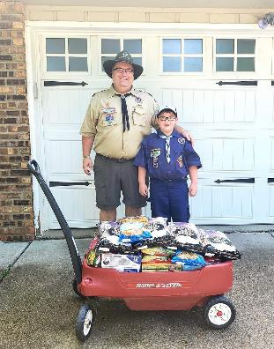
WAGON SALES
Start early with Online Direct or take order!
Sell door-to-door
Visit 30 homes in your neighborhood
With Online Direct, text order to customer to complete purchase on their phone to keep a social distance
Sell to friend & family
Sell at work

Slide 17
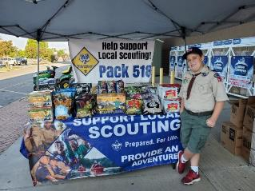
STOREFRONTS
We’ve got all the equipment you need!
Table
Banner
Tablecloth
Cashbox
Popcorn
Laminated instructions,
reminders, and info
Bring your own device
Signup for storefront shifts in the Trail’s End App.

Slide 18
CREDIT / DEBIT
CREDIT SALES ARE BEST FOR SCOUTS
TELL YOUR CUSTOMERS, “WE PREFER CREDIT/DEBIT”
Trail’s End pays for all credit card fees!
Bigger Rewards – Earn 1.5pts per $1 sold in the Trail’s End App
Safer – Scouts don’t have to handle cash
Higher Sales – Customers spent 27% more with credit vs. cash in 2019
Easier – Parents turn in cash sales with credit/debit payments to the unit
Hardware – Scouts can accept credit/debit with Square readers or manual entry

Slide 19
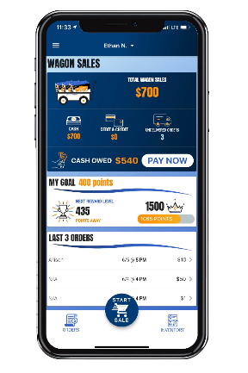
CREDIT / DEBIT
Turn in cash collected from Wagon Sales with credit/debit payment to your unit.
Navigate to Wagon Sales in the App
Click PAY NOW
Enter the payment amount
You don’t have to pay the full amount at once
Swipe your credit card or enter manually
No need to carry around cash until you see your Popcorn Kernel. Pay your unit through the app at your convenience!

Slide 20
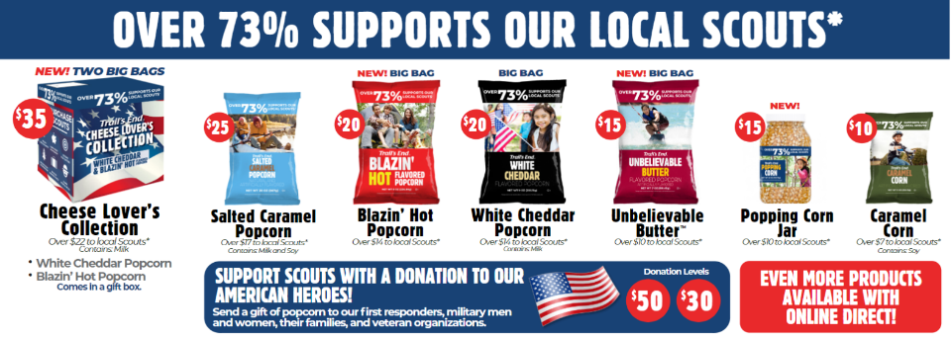
PRODUCTS - TRADITIONAL
$X
$X

Slide 21
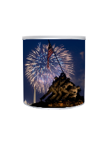
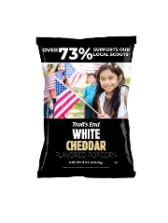
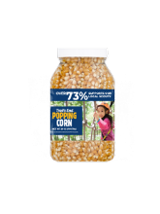
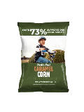
PRODUCTS - ONLINE DIRECT
$35 Chocolatey Caramel Crunch Tin
$30 Chocolatey Caramel Crunch
$30 Dark Chocolate Salted Caramels
$25 Salted Caramel Popcorn
$25 Unbelievable Butter 12pk
$20 White Cheddar Popcorn
$20 Blazin’ Hot Popcorn
$15 Unbelievable Butter Popcorn
$15 Popping Corn Jar
$10 Caramel Corn
Customers pay shipping: $7.99 plus $.99 per additional item (bundles of 2 are $8.98; bundles of 3 are $9.97). Products & pricing subject to availability and change.

Slide 22
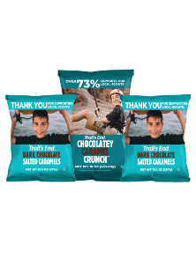
PRODUCTS - ONLINE DIRECT
$70 Chocolate Lover’s Tin
(2) Dark Chocolate Salted Caramels
(1) Chocolatey Caramel Crunch
$65 Chocolate Lover’s Bundle
(2) Dark Chocolate Salted Caramels
(1) Chocolatey Caramel Crunch
$35 Cheese Lover’s Bundle
(1) White Cheddar Popcorn
(1) Blazin’ Hot Popcorn
Customers pay shipping: $7.99 plus $.99 per additional item (bundles of 2 are $8.98; bundles of 3 are $9.97). Products & pricing subject to availability and change.

Slide 23
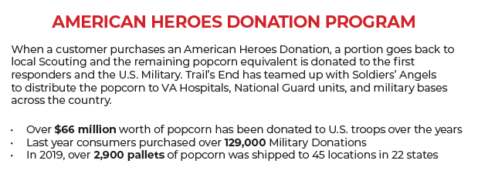
DONATIONS

Slide 24
KEY DATES for Unit
Online Direct & Wagon Start
Storefront Signups Live
First Storefront Sale
Last Day to Return Wagon
Last Storefront Sale
Payment Due
Popcorn Party
July 1
July 23
August 25
October 12
October 14
TBD
TBD
24

Slide 25
SUPPORT
CONTACT TRAIL’S END SUPPORT
JOIN OUR FACEBOOK GROUP
Text SCOUTFB to 62771 to join
JOIN OUR WEBINARS
Text WEBINAR to 62771 to register
VISIT OUR WEBSITE
www.trails-end.com
EMAIL US:
support@trails-end.com
NEED HELP? VISIT OUR FAQs:
www.support.trails-end.com
UNIT CONTACT INFO
Enter Name: Unit Kernel
@gmail.com
(000) 000-0000
Enter Name: Unit Co-Kernel
@gmail.com
(000) 000-0000
25

Slide 26
THANK YOU
Have a Great Fundraiser!
AMERICA’S POPCORN SALE - FUNDING ADVENTURES!
OVER $4 BILLION BACK TO SCOUTING SINCE 1980

Slide 27
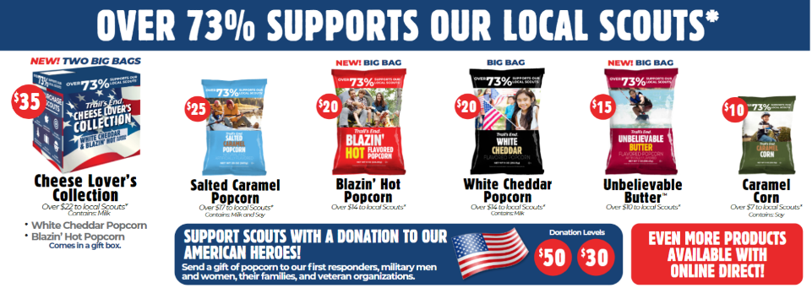
Appendix: Traditional Products
$X
$X

